Slide 1


Slide 2
Assignment 01
Open Consultation

Slide 3
Context behind the scenarios
Motivation. Why these particular scenarios? Conflict & communication
Universal education in the context of the internet and learning on your own (with no formal teacher assigned)
Learning your native language to understand the local culture (or to preserve the cultural heritage of your country and consequently all people of the world) & a second language for universal communication
Math as part of a universal culture (symbols as a language)
5. Other additions (if you have any)
Notes:
Who are doing which scenario?

Slide 4
Scenario 1
Similar situations
http://www.israelmgelfand.com/egcpm.html
https://www.komal.hu/info/miazakomal.e.shtml

Slide 5
Scenario 2
Some ideas
Check from where the content is taken, com sites? Nice figures content might be not that accurate. Check some of my links
Tags are not Metadata, but “Just More Content” – to Some People
https://icwsm.org/papers/2--Berendt-Hanser.pdf

Slide 6
What you could do further?
Check how other people approaches design – refer the additional reading material
Think of the system that contain your database as already implemented. Who are the main users? What they will do at the website most of the time? What sort of information will they want to know or query from the site?
Uses of databases
Data minding
Task automation & collaboration

Slide 7
Books/Articles that will help you get started
‘Database Design From Novice to Professional’ by Clare Churcher (for those who want to read a simple text on data modelling and databases) available as an eBook at the UVic library
Design Your Own Database from Concept to Implementation or How to Design a Database without Touching a Computer
https://www.dartmouth.edu/~bknauff/dwebd/2004-02/DB-intro.pdf

Slide 8
Your questions?

Slide 10
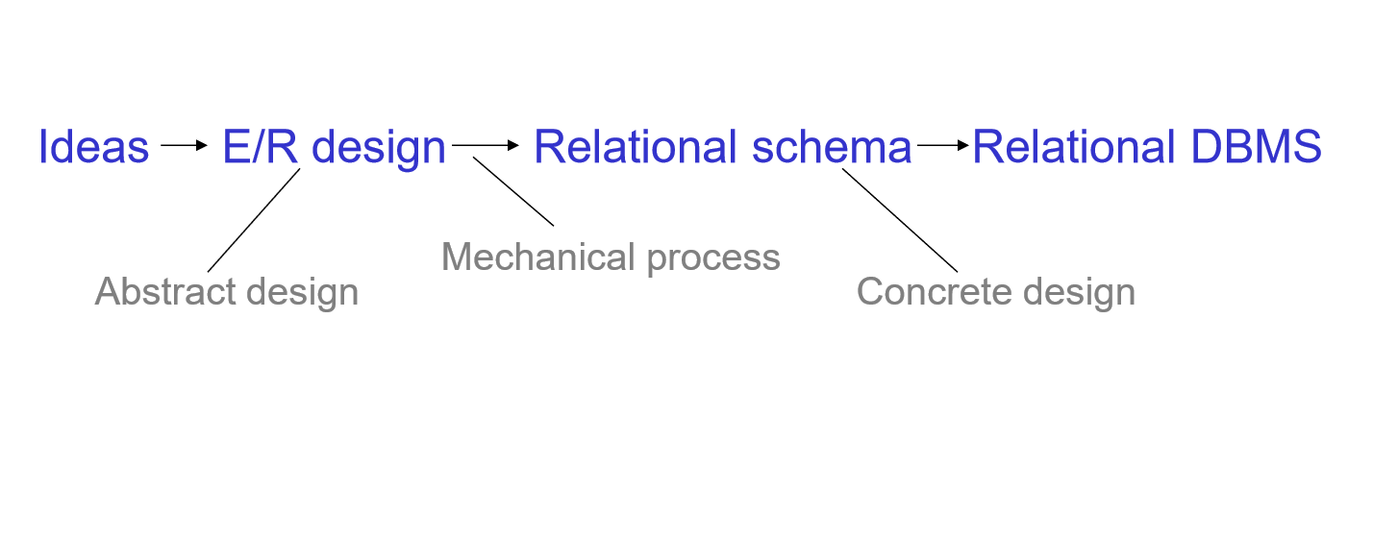

Slide 11
Database Design Steps
(1) Requirements Analysis: What data to store, what the users want from the database
(2) Conceptual Database Design: high level description of the data (ER Model)
(3) Logical Database Design: convert an ER schema into a relational database schema.

Slide 12
Database Design Steps (continued)
(4) Schema Refinement: analyze the collection of relations in the relational database schema to identify potential problems, and refine it (normalization relations).
(5) Physical Database Design: consider typical expected workloads that our database must support and further refine the database design to ensure that it meets desired performance criteria.
(6) Security Design: we identify different user groups and different roles played by various users

Slide 13
Entity Relationship (E/R) Model
Entity-relationship (ER) data model allows us to describe the data involved in a real-world enterprise in terms of objects and their relationships and is widely used to develop an initial database design.
Notes:
we covered this part in lectures

Slide 14
Beyond the ER Model
ER diagram is just an approximate description of the data, constructed through a very subjective evaluation of the information collected during requirements analysis.
A more careful analysis can often refine the logical schema obtained at the end of Step 3. Once we have a good logical schema, we must consider performance criteria and design the physical schema.

Slide 15
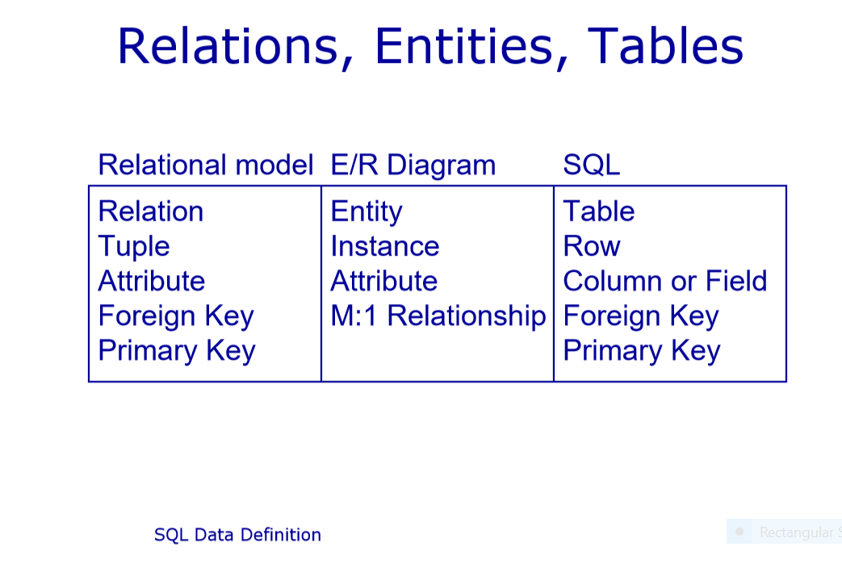
Notes:
Concepts in relational model, E/R diagram and SQL

Slide 16
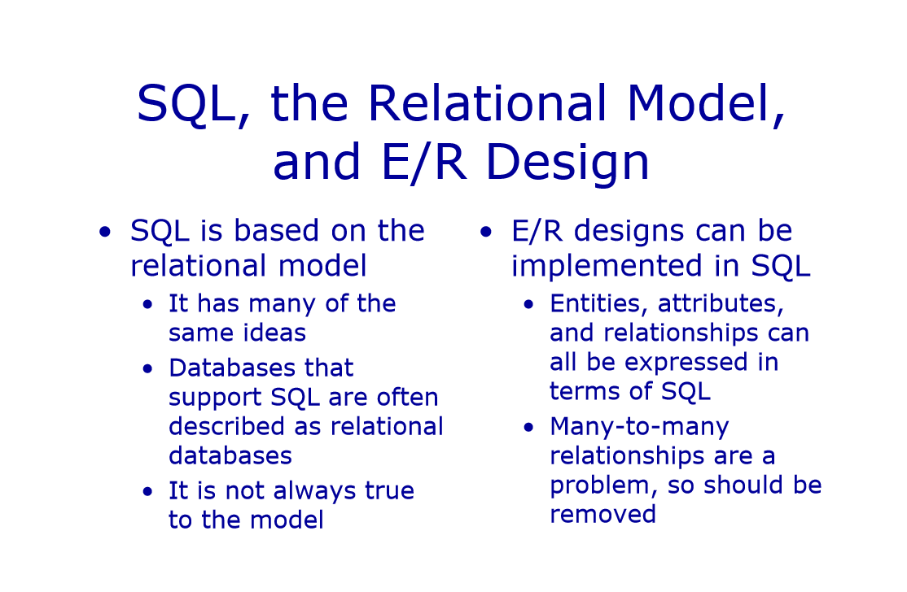

Slide 17
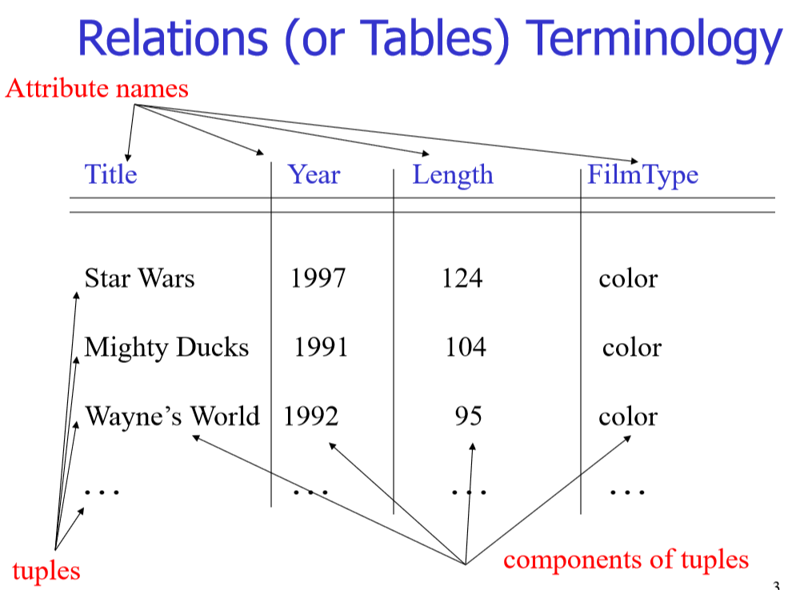
Notes:
This is in SQL

Slide 18
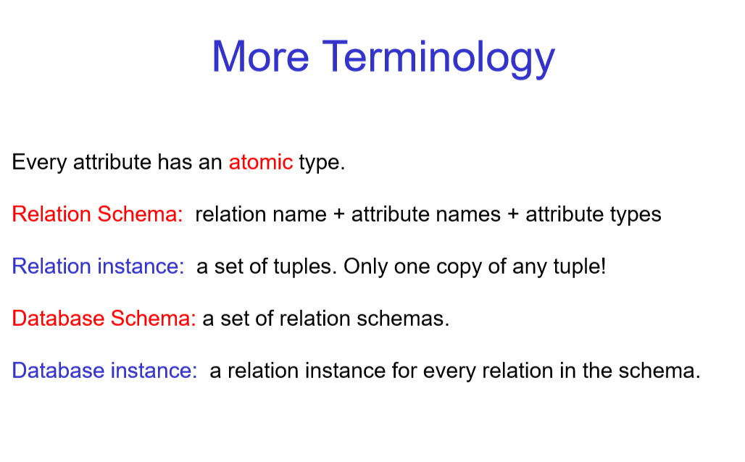

Slide 19
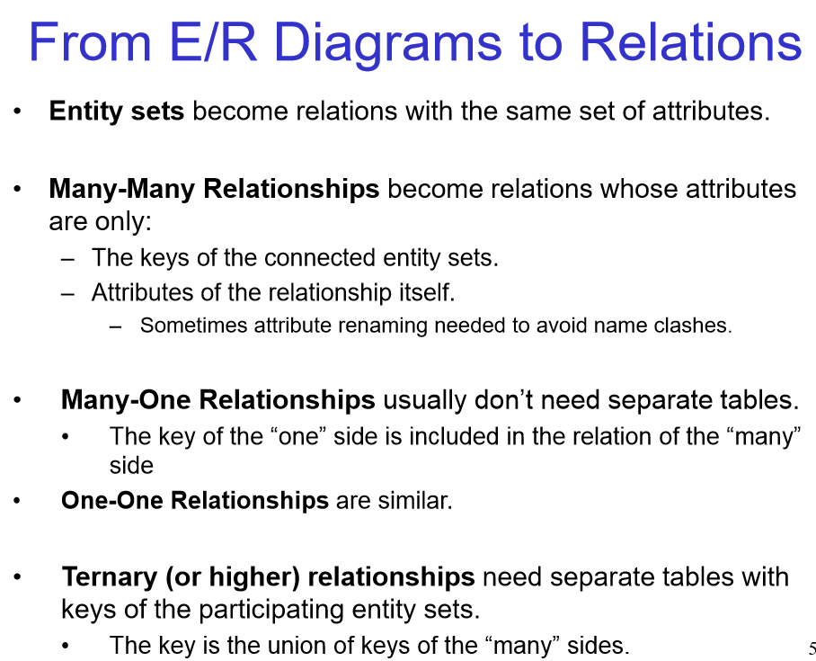

Slide 20
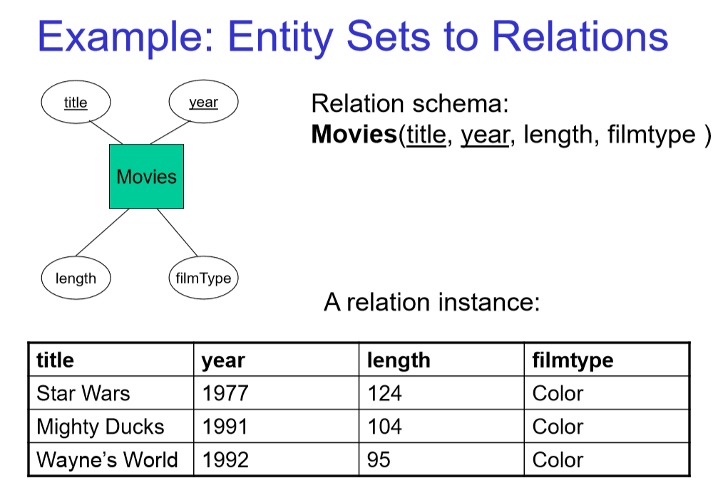

Slide 22
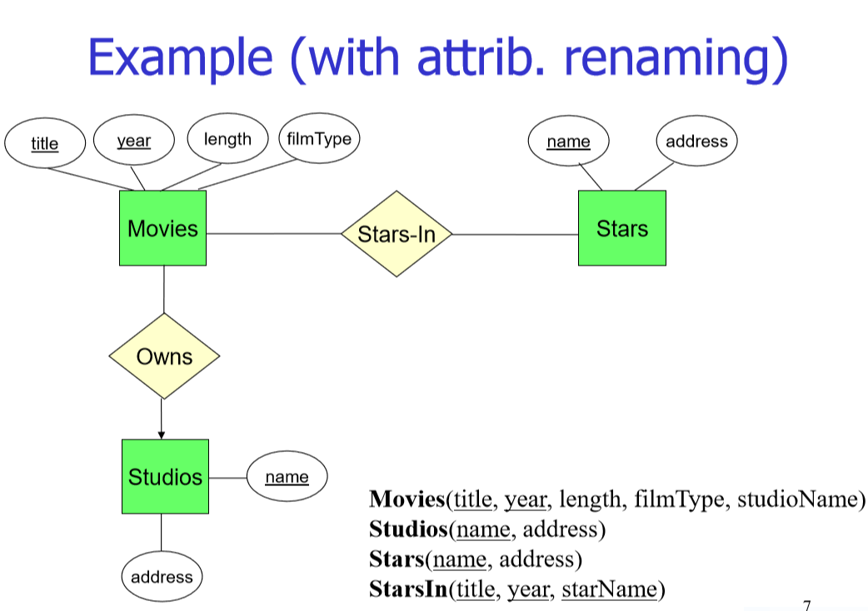
Many-Many Relationships become relations whose attributes are only: – The keys of the connected entity sets. – Attributes of the relationship itself. – Sometimes attribute renaming needed to avoid name clashes
Notes:
Many-One Relationships usually don’t need separate tables. The key of the “one” side is included in the relation of the “many” side •

Slide 24
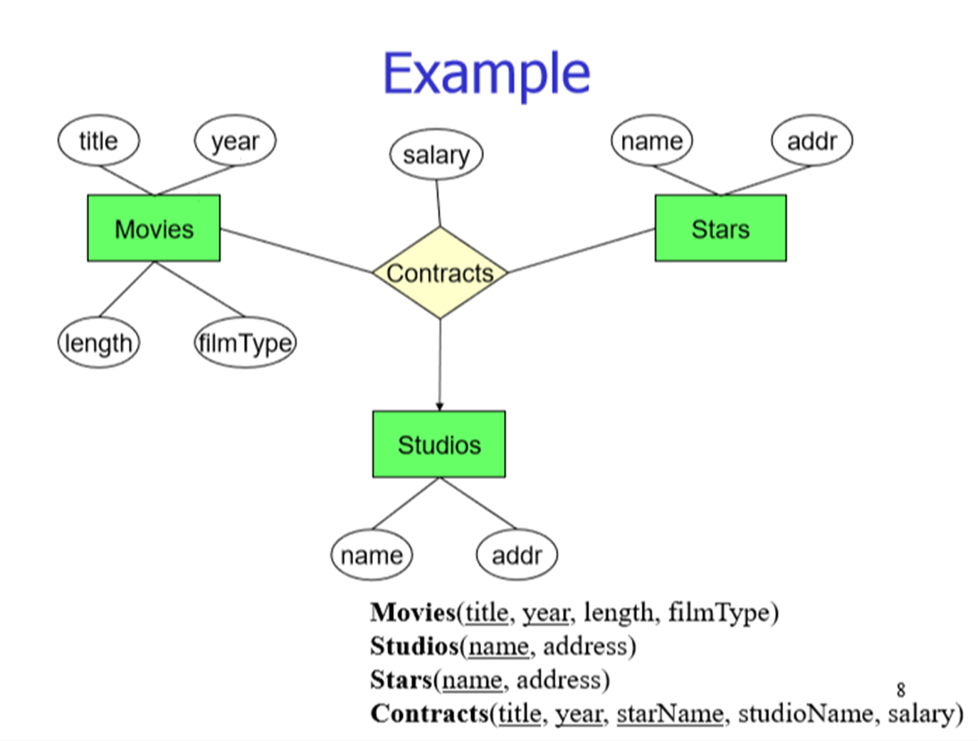
Ternary (or higher) relationships need separate tables with keys of the participating entity sets. The key is the union of keys of the “many” sides

Slide 25


Slide 26
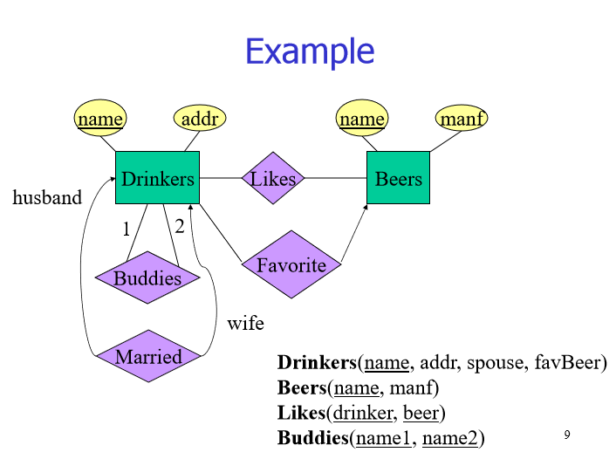

Slide 27
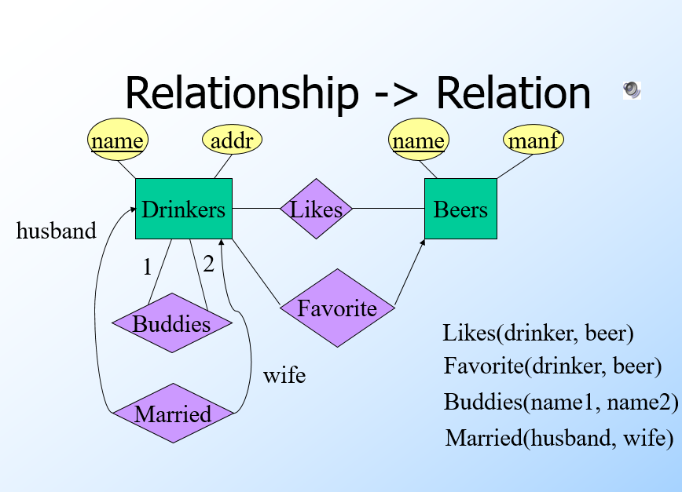

Slide 28
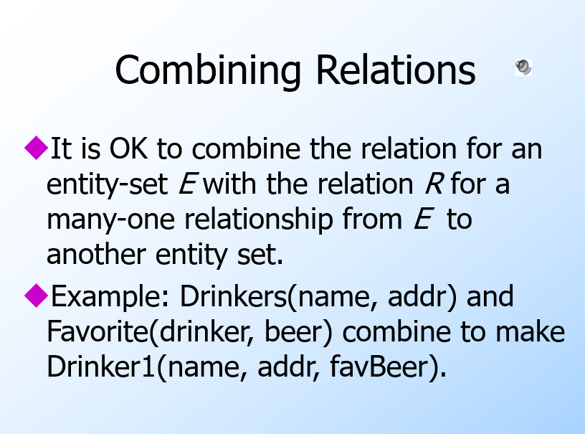

Slide 29
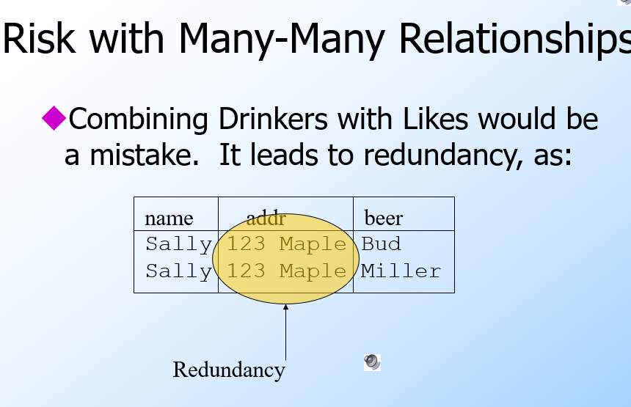

Slide 30
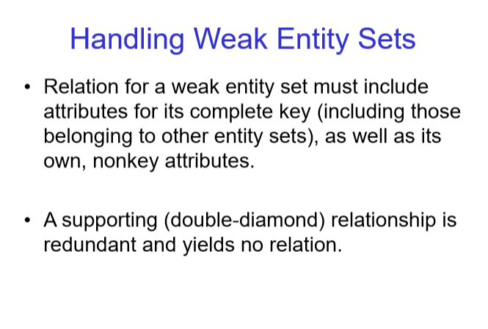

Slide 31
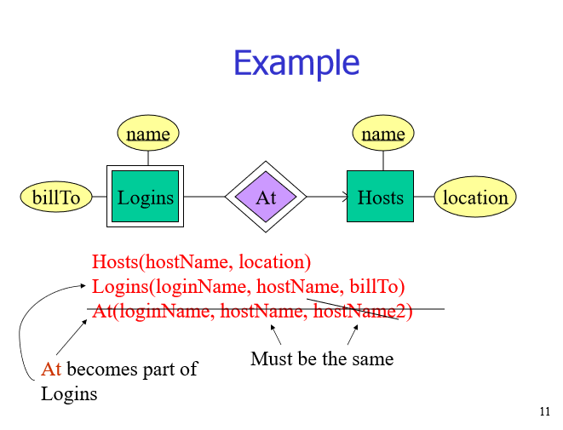

Slide 32


Slide 33
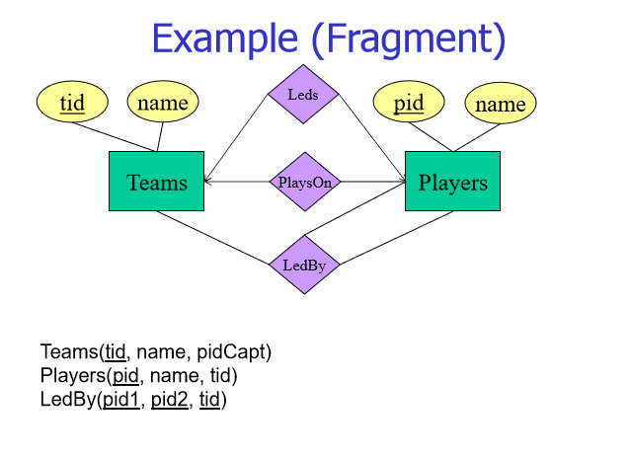

Slide 34
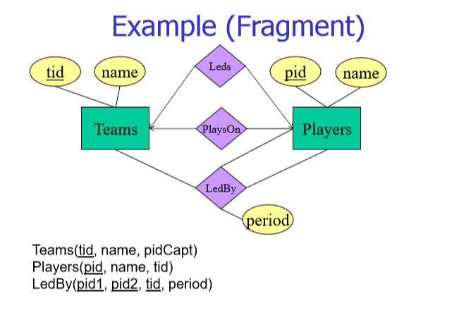

Slide 35
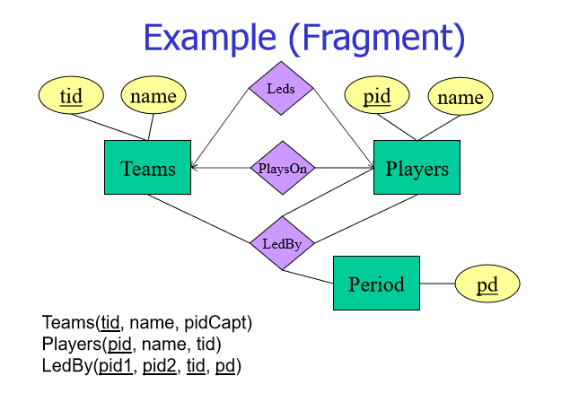

Slide 36
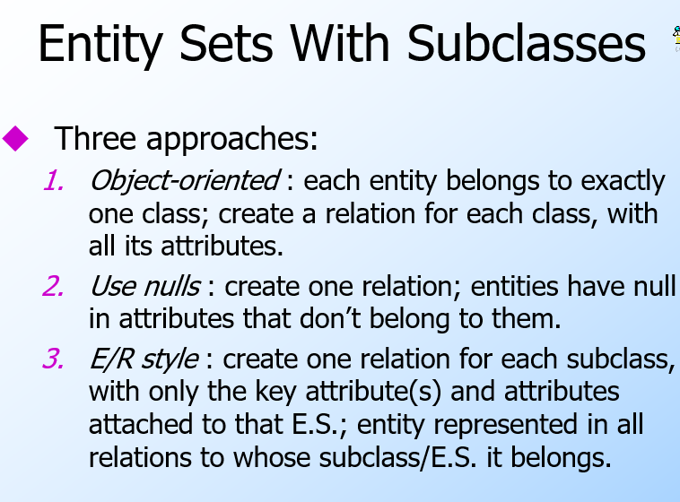

Slide 37
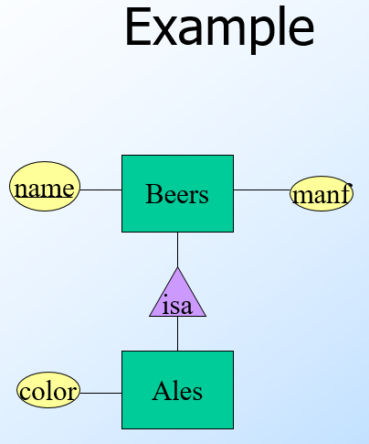

Slide 38
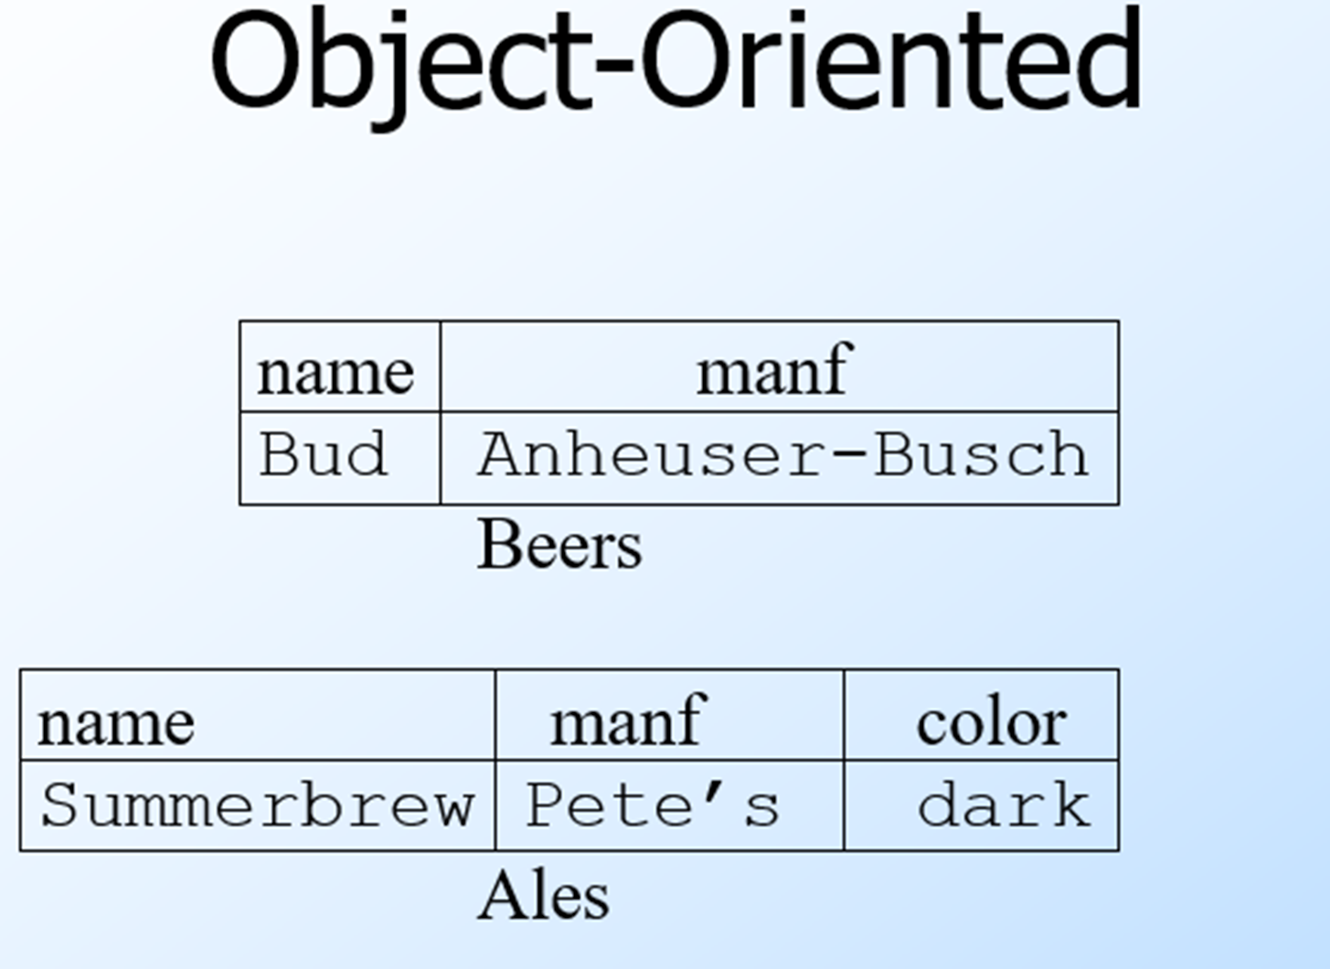

Slide 39
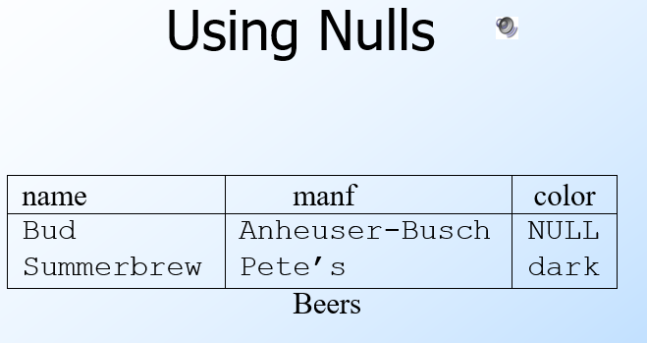

Slide 40
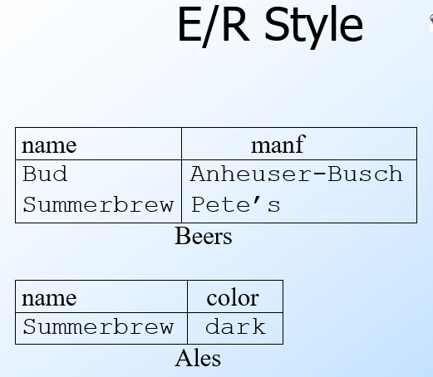

Slide 41
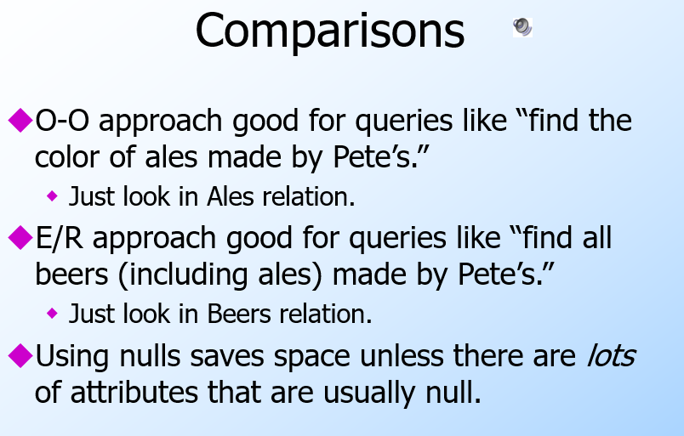

Slide 42
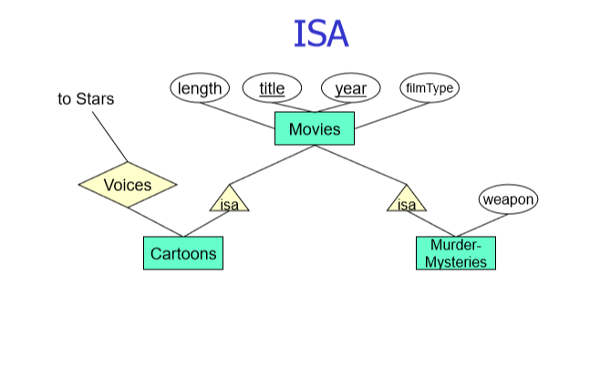

Slide 43
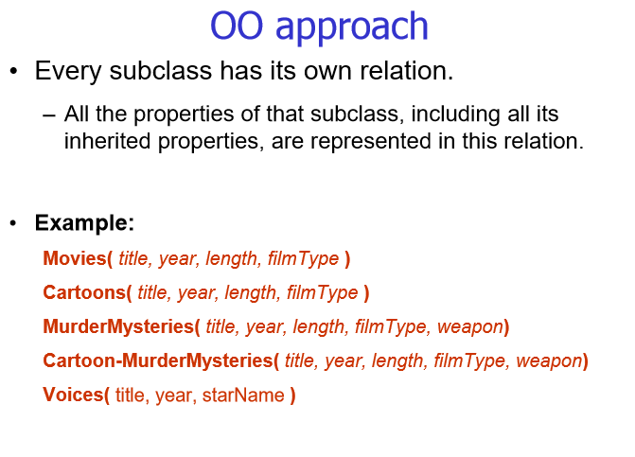

Slide 44
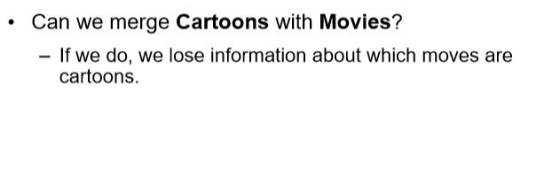

Slide 45
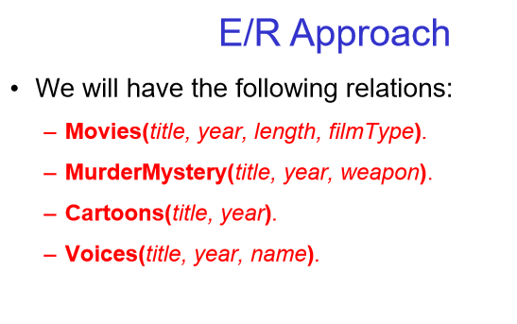

Slide 46
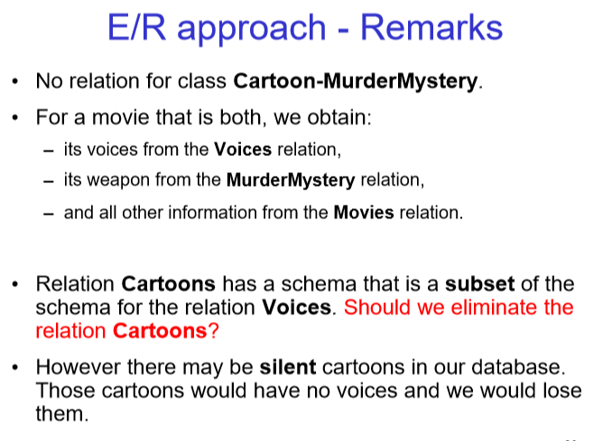

Slide 47
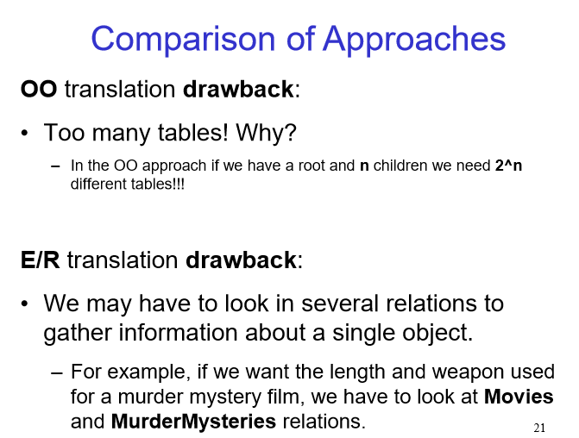

Slide 48
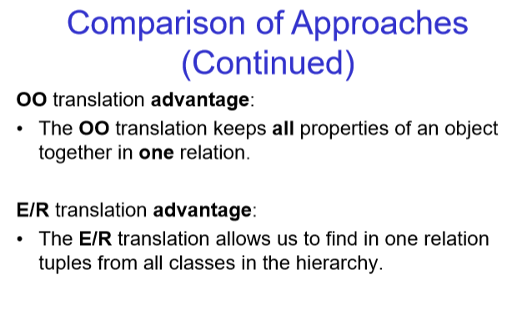

Slide 49
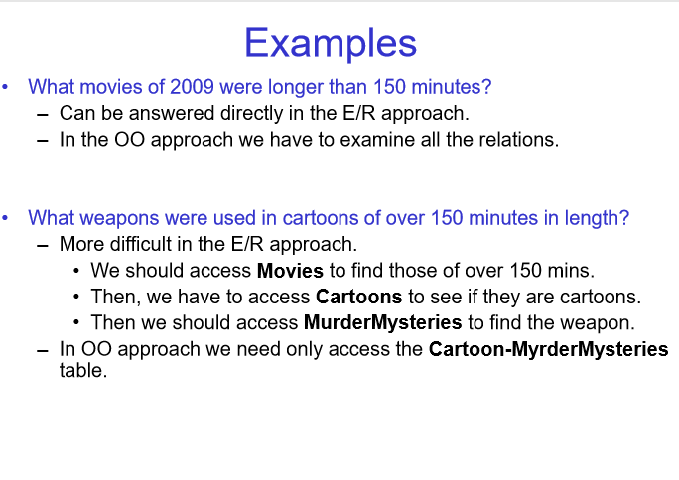

Slide 50
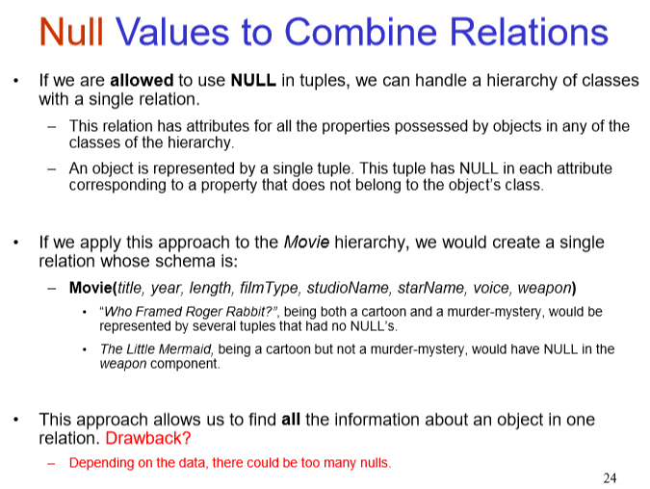

Slide 51
Read the text book Chapter 4 pages 153 to 163
Do few exercises from each section for exam practice

Slide 52
Check slides 1 to 36 of lecture 2 ‘Relational model & SQL’
To remind yourself about relational schemas, database schemas, table declarations, ADD/DROP tables etc. and refer Sections 2 & 3 of Chapter 2 – textbook

Slide 53
Textbook material reference you should do
Entity-Relationship Model; Design Principles – Chapter 4 Sections 1, 2, 3.1, 3.2 and 4
Relational Model; Converting E/R Models to Relations; Defining Relations in SQL – Chapter 2 Section 2, Chapter 4 Sections 5 & 6 and Chapter 2 Section 3

Slide 54
Normalization

Slide 55
Normalization of your tables
Setup proper tables - should minimize redundancy without losing any data i.e. use the least amount of storage space for our database while still maintaining all links between data
A normalized DB schema avoids certain anomalies when inserting, updating, or deleting data and, therefore, helps to keep consistent data in the database
Normalization procedure is nothing more than common sense

Slide 56
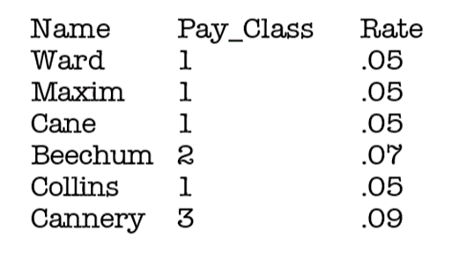
Functional Dependencies
Crucial in understanding the Normalization Process
Definition: A column is functionally dependent on another column if a value 'A' determines a single value for 'B' at any one time
In the table the field 'Rate' is functionally dependent on the field 'Pay Class'. In other words, Pay Class determines Rate
Notes:
Functional dependencies explained here in a more practical manner using a table. Chapter 3 textbook a more theoretical approach using math – first order logic

Slide 57
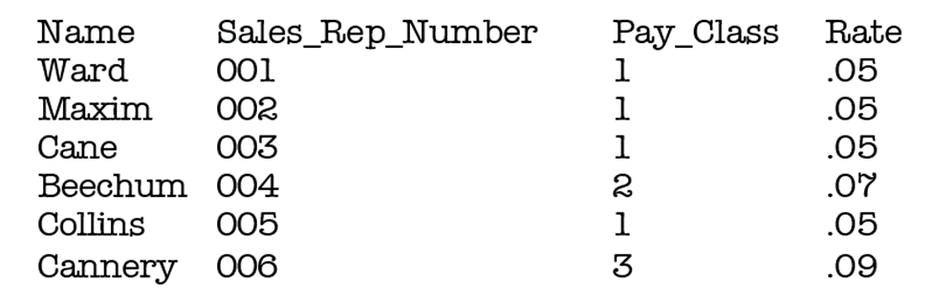
Functional Dependencies
Taking the same table as above, add Sales_Rep_Number column
Find some more Functional Dependencies?
Pay Class determines Rate.
Sales Rep Number determines Last Name. Only one Sales Rep Number for each Last Name. This fits the definition of a Functional Dependency

Slide 58
Functional Dependencies
But does Last Name functionally determine anything?
Currently, for example Ward will only give you one Sales Rep Number
What if we hired another person with the name Ward?
Then you would have two values for your Sales Rep Number, and then Last Name would no longer functionally determine anything

Slide 59
On Keys and Functional Dependencies
If we know the functional dependence, we can clarify keys?
Definition:
Column A is the primary key for table T if:
Property 1. All columns in T are functionally dependent on A
Property 2. No sub collections of the columns in table T also have Property 1.
If all the columns in the relational table are dependent on one and only one column, then that column is the key. Now, occasionally Property 2 is broken, and two or more columns are candidates for the Primary Key. These keys are then called candidate keys. From these candidate keys, one key is chosen and the others are called alternate keys.
Notes:
We already know about the last point

Slide 60
In the given table the primary key is the Sales Rep Number, as it fits the definition of a Primary Key. Everything in the table is dependent on the Sales Rep Number

Slide 61
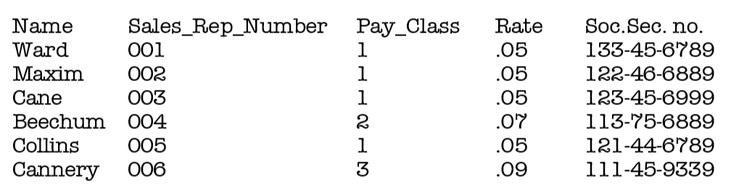
Now, we have two Candidate Keys, Sales Rep Number and Social Security Number. So, what we have to decide is which field to use, as both will be unique. It would be best to have the Sales Rep Number as the Primary Key
Notes:
Now, let us have the Social Security number of the employee in the table as well

Slide 62
Normalization & Normal Forms

Slide 63
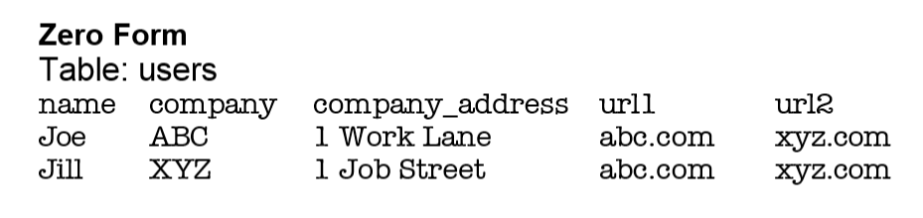
Create a table of user information, and we want to store each users' Name, Company, Company Address, and some personal bookmarks, or urls.
Notes:
You might start by defining a table structure like this:

Slide 64
table is in Zero Form
We would say this table is in Zero Form because none of our rules of normalization have been applied yet.
Notice the url1 and url2 fields -- what do we do when our application needs to ask for a third url? Do you want to keep adding columns to your table?
Notes:
Some other table with repeating groups for this scenario would be a column named url where you have comma separated url1, url2, url3 etc.

Slide 65

Repeating data example
Instead of this
We could have a single column named url with the data shown as follows:
url
abc.com, xyz.com, stu.com, etc.
But, still repeating data and we have to apply 1NF

Slide 66
First Normal Form (or 1NF)
The first normal form, sometimes called 1NF, states that each attribute or column value must be atomic. That is, each attribute must contain a single value, not a set of values or another database row. First Normal Form Rules are:
1. Eliminate repeating groups in individual tables.
2. Create a separate table for each set of related data.
3. Identify each set of related data with a primary key.

Slide 67
First Normal Form
Notice how we're breaking that first rule by repeating the url1 and url2 fields?
And what about Rule Three, primary keys?
Notes:
Rule 3 is Identify each set of related data with a primary key

Slide 68
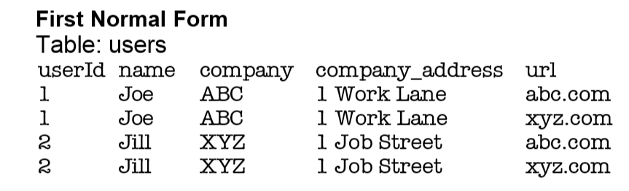
First Normal Form
Rule Three basically means we want to put some form of unique, auto incrementing integer value into every one of our records. Otherwise, what would happen if we had two users named Joe and we wanted to tell them apart? When we apply the rules of the First Normal Form we come up with the following table:
Notes:
Note that rather than having repeating columns for urls, now we have them all in one column (next slide)

Slide 69
First Normal Form
Note further that rather than having repeating columns for urls, now we have them all in one column

Slide 70
First Normal Form
We've solved the problem of url field limitation, but look at the problem we have now. Every time we input a new record into the users table, we've got to duplicate all the company and user name data. Not only will our database grow much larger than we'd ever want it to, but we could easily begin corrupting our data by misspelling some of that redundant information. Let's apply the rules of Second Normal Form
Notes:
Now our table is said to be in the First Normal Form.

Slide 71
Second Normal Form (or 2NF)
A schema is said to be in second normal form (also called 2NF) if all attributes that are not part of the primary key are fully functionally dependent on the primary key, and the schema is already in first normal form. What does this mean?
It means that each non-key attribute must be functionally dependent on all parts of the key. That is, if the primary key is made up of multiple columns, every other attribute in the table must be dependent on the combination of these columns.
Create separate tables for sets of values that apply to multiple records.
2. Relate these tables with a foreign key.

Slide 72
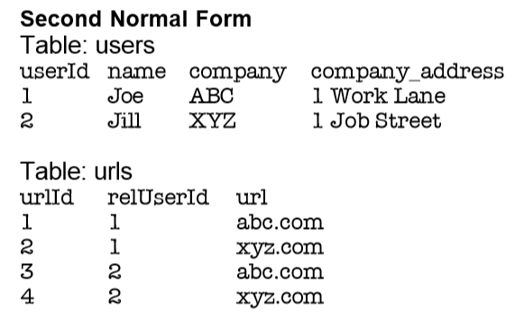
Second Normal Form
We break the url values into a separate table so we can add more in the future without having to duplicate data. We'll also want to use our primary key value to relate these fields:

Slide 73
Second Normal Form
we've created separate tables and the primary key in the users table, userId, is now related to the foreign key in the urls table, relUserId. We're in much better shape.
But what happens when we want to add another employee of company ABC? Or 200 employees?
Now we've got company names and addresses duplicating themselves all over the place, a situation just rife for introducing errors into our data. So we'll want to look at applying the Third

Slide 74
Third Normal Form (3NF)
Eliminate fields that do not depend on the key
You may sometimes hear the saying "Normalization is about the key, the whole key, and nothing but the key." Second normal form tells us that attributes must depend on the whole key. Third normal form tells us that attributes must depend on nothing but the key.
Formally, for a schema to be in third normal form (3NF), we must remove all transitive dependencies, and the schema must already be in second normal form. Okay, so what's a transitive dependency?

Slide 75
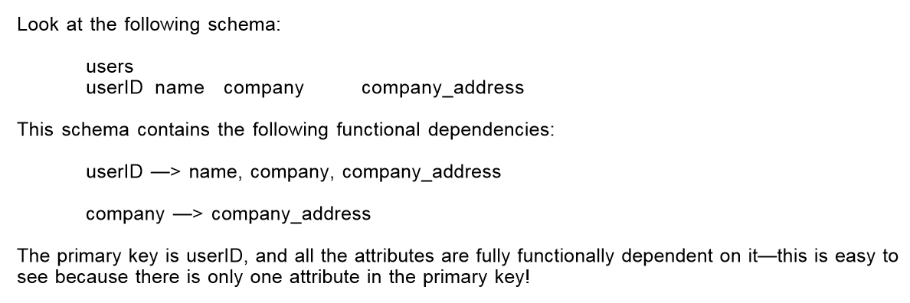

Slide 76
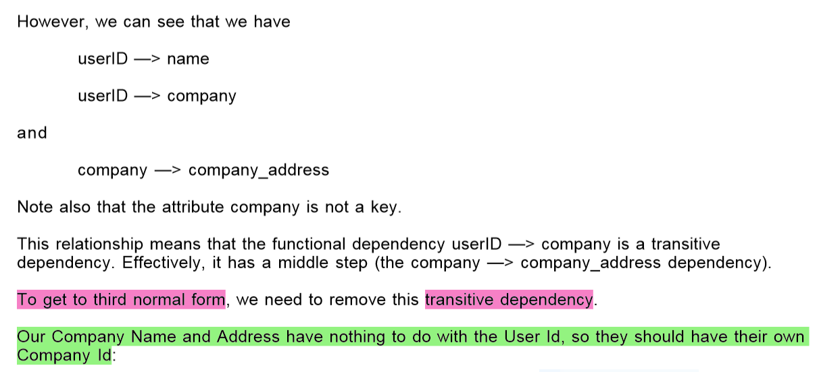

Slide 77
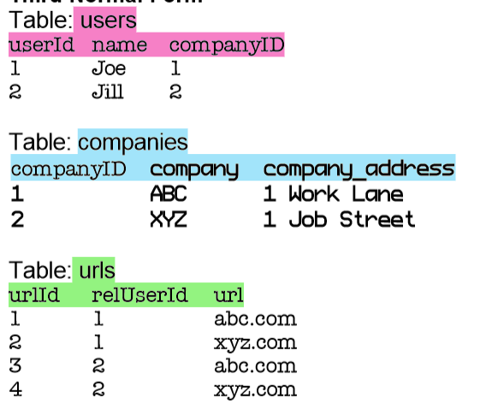
Tables in the Third Normal Form

Slide 78
Tables in the Third Normal Form
Now we've got the primary key compId in the companies table related to the foreign key in the users table called relCompId, and we can add 200 users while still only inserting the name "ABC" once.
Our users and urls tables can grow as large as they want without unnecessary duplication or corruption of data. Most developers will say the Third Normal Form is far enough, and our data schema could easily handle the load of an entire enterprise, and in most cases they would be correct

Slide 79
Tables in the Third Normal Form
look at our url fields - do you notice the duplication of data? This is perfectly acceptable if we are not pre-defining these fields. If the HTML input page which our users are filling out to input this data allows a free-form text input there's nothing we can do about this, and it's just a coincidence that Joe and Jill both input the same bookmarks. But what if it's a drop-down menu which we know only allows those two urls, or maybe 20 or even more. We can take our database schema to the next level, the Fourth Form, one which many developers overlook because it depends on a very specific type of relationship, the many-to-many relationship, which we have not yet encountered in our application

Slide 80
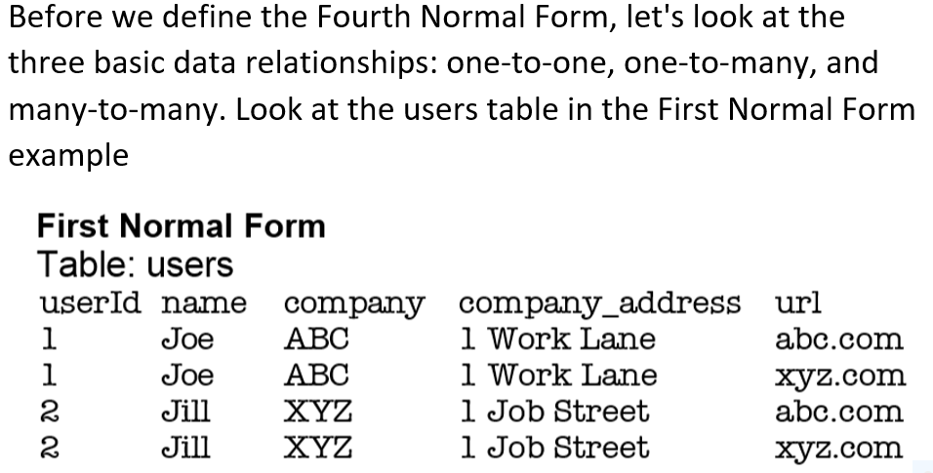
Data Relationships
Notes:
one-to-one relationship

Slide 81
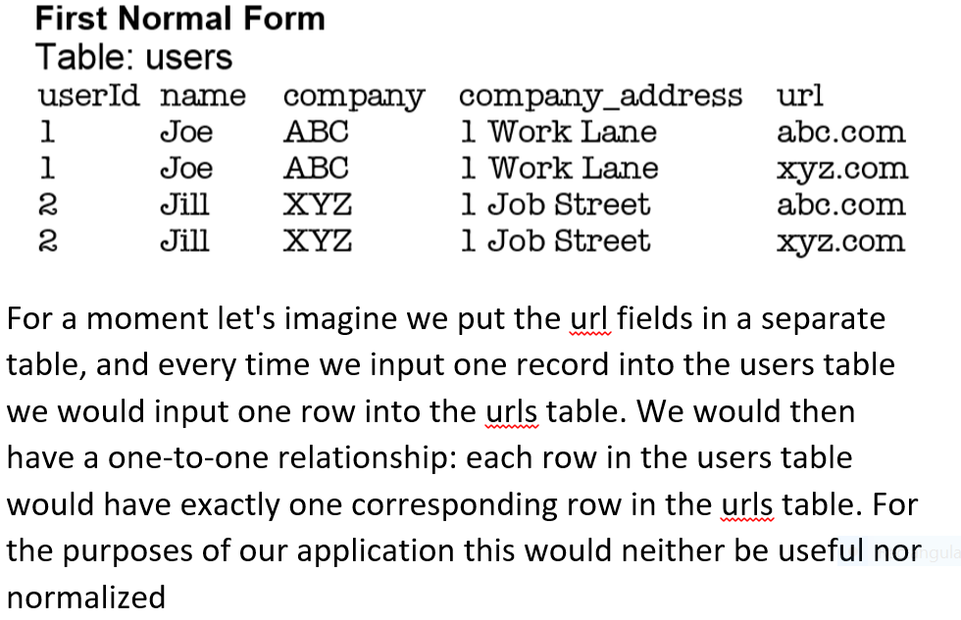
Data Relationships

Slide 82
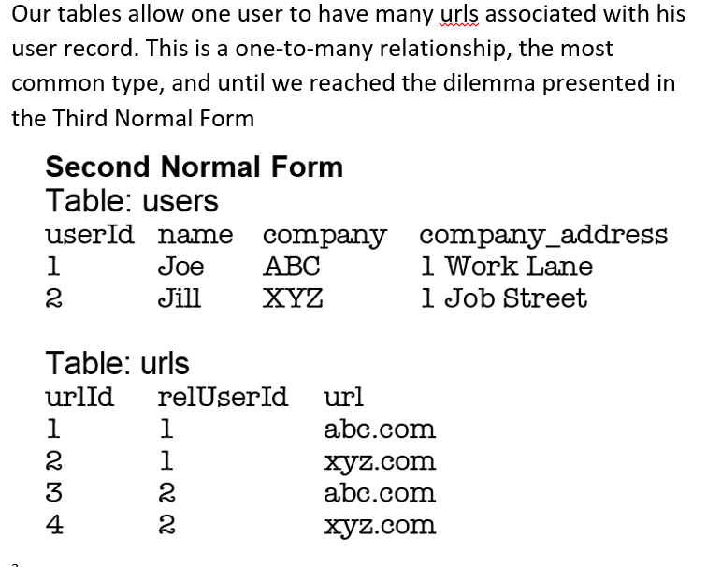
Data Relationships-look at the tables in the Second Normal Form example

Slide 83
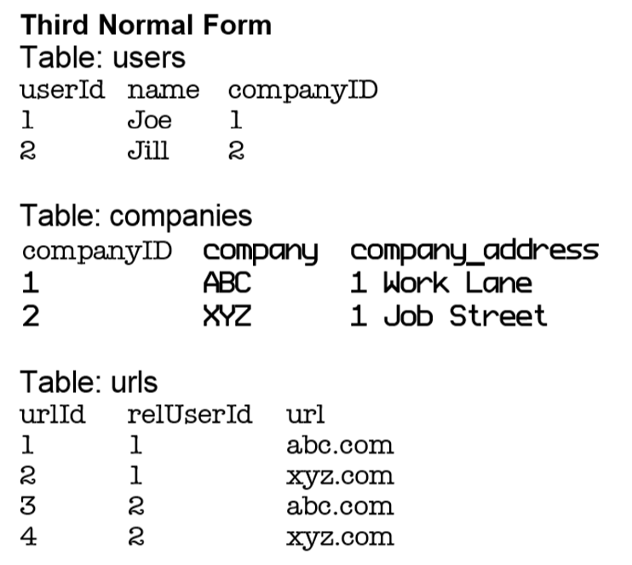
The many-to-many relationship, however, is slightly more complex. Notice in the Third Normal Form example one user is related to many urls.

Slide 84
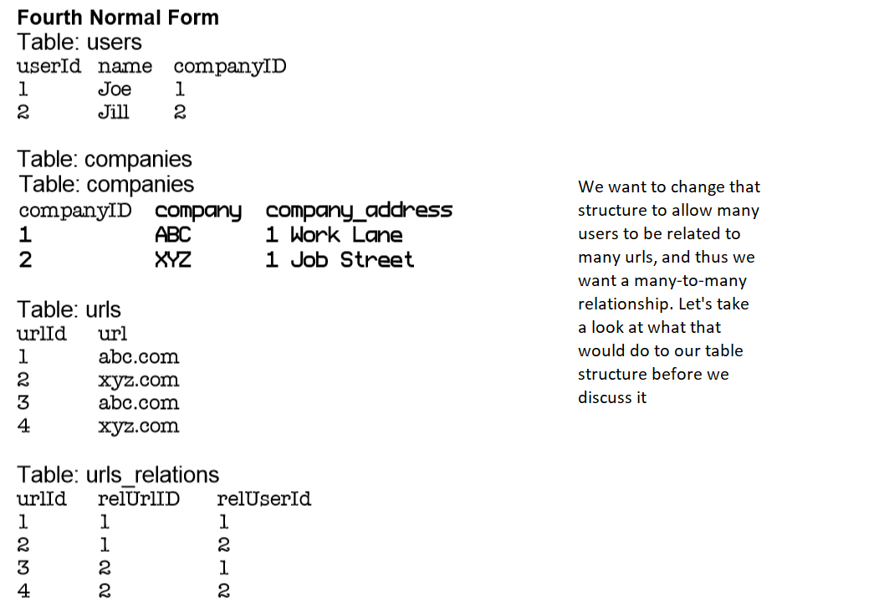

Slide 85
Data Relationships (4NF)
to decrease the duplication of data (and in the process get to the Fourth Form of Normalization), by creating a table full of primary and foreign keys in url_relations.
to remove the duplicate entries in the urls table by creating the url_relations table.
accurately express the relationship that both Joe and Jill are related to each one of, and both of, the urls.
what is the Fourth Form of Normalization?

Slide 86
Fourth Normal Form
In a many-to-many relationship, independent entities cannot be stored in the same table.
Since it only applies to the many-to-many relationships, most developers ignore this rule
But useful in certain situations, such as this one
Helped to streamline the urls table to remove duplicate entries and movethe relationships into their own table.

Slide 87
Fifth Normal Form
in most cases probably not required
The original table must be reconstructed from the tables into which it has been broken down
benefit of applying this rule ensures you have not created any unnecessary columns in your tables, and that all of the table structures you have created are only as large as they need to be
a good practice to apply this rule, but unless you're dealing with a very large data schema you probably won't need it.

Slide 88
Normalization summary
creating an efficient table structure consists of breaking down the table columns into simpler and simpler components
the process ends up with tables and with many more columns than originally thought as necessary, but each of those columns contain more basic information.
while the structure might look more complex, the contents of each column in respective tables have been reduced to the simplest useful components.

Slide 89
Acknowledgment:
Some slides/content taken from material presented in these courses/articles:
CSC 370 – Database Systems Introduction by Alex Thomo http://webhome.cs.uvic.ca/~thomo
Design Your Own Database from Concept to Implementation or How to Design a Database without Touching a Computer
https://www.dartmouth.edu/~bknauff/dwebd/2004-02/DB-intro.pdf
SQL Data Definition http://www.cs.nott.ac.uk/~psznza/G51DBS/dbs5.pdf
4. The Relational Database Model
www5.csudh.edu › classes › cis473 › Spring07 › handouts › DbaseSystem

Slide 90
Read the document (Home Work)
Design Your Own Database from Concept to Implementation or How to Design a Database without Touching a Computer
https://www.dartmouth.edu/~bknauff/dwebd/2004-02/DB-intro.pdf

Slide 91
Thank you!
Questions?

